Slide 1
Systematic Review of indicators for emotional factors
Qualitative Evaluation
Literary Review of Metrics
CRNs
Ethics Committees/HRA Input
Derive 3 PILS for an RCT
Lab Test 2 PILS
Revision
Qualitative Evaluation
recall | understanding
INVOLVE Program
RCT of 2 PILs
Which emotions matter?
How much do they matter?
Recruitment & Retention effects

Slide 2
Emotion
PIL
Motivation to participate in RCTs
Review Literature and PIL
Understand & trust PIL
Consent
Join RCT
Stay in RCT
PIL
Experiences in RCT

Slide 3
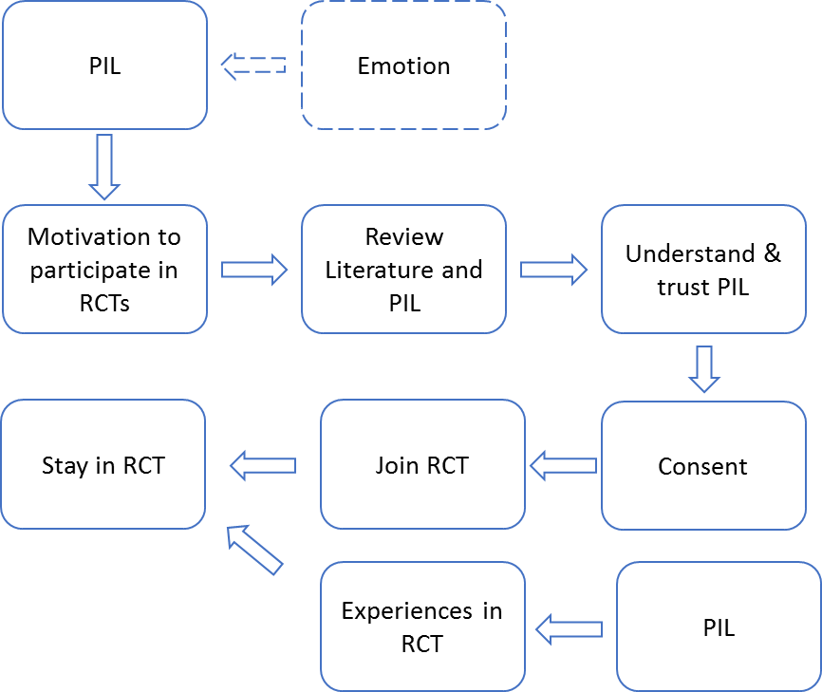
PIL
Emotion
Motivation to participate in RCTs
Review Literature and PIL
Understand & trust PIL
Stay in RCT
Join RCT
Consent
Experiences in RCT
PIL

Slide 4
MSc Project
PhD 2nd Year
Are PILs different?
Comparison with emotive texts
Objectively create casual version of a leaflet
Case Study: Prita’s RCT (Thailand)
Identify PILs phrases that hinder / enhance readability & recruitment
Randomized Study: The impact of revised leaflets on recruitment rates
6
1
Are PILs different?
Comparison with news articles
4
Simulated study: Mechanical Turk or Patient Group
Simulated study: stakeholder group assessment
10
Content Analysis: PILs’ words and association with recruitment
3
Objectively create emotive version of a leaflet
7
8
Identify the effect of emotive words on readability &
recruitment
Create Personas profiles
2
5
9
11
12
UoS Ethics application
NHS Ethics application
May-June
June
Aug-Oct
Nov-Feb
Apr-May
Characterise the Patient Information Leaflets (PILs)
Design emotive alternative to current leaflets
Characterize the leaflet audience
Understand the stakeholders needs
Assess performance of leaflet's changes in lab study
Assess performance of leaflet's changes in a field study
Assess the validity of the lexicon

Slide 5
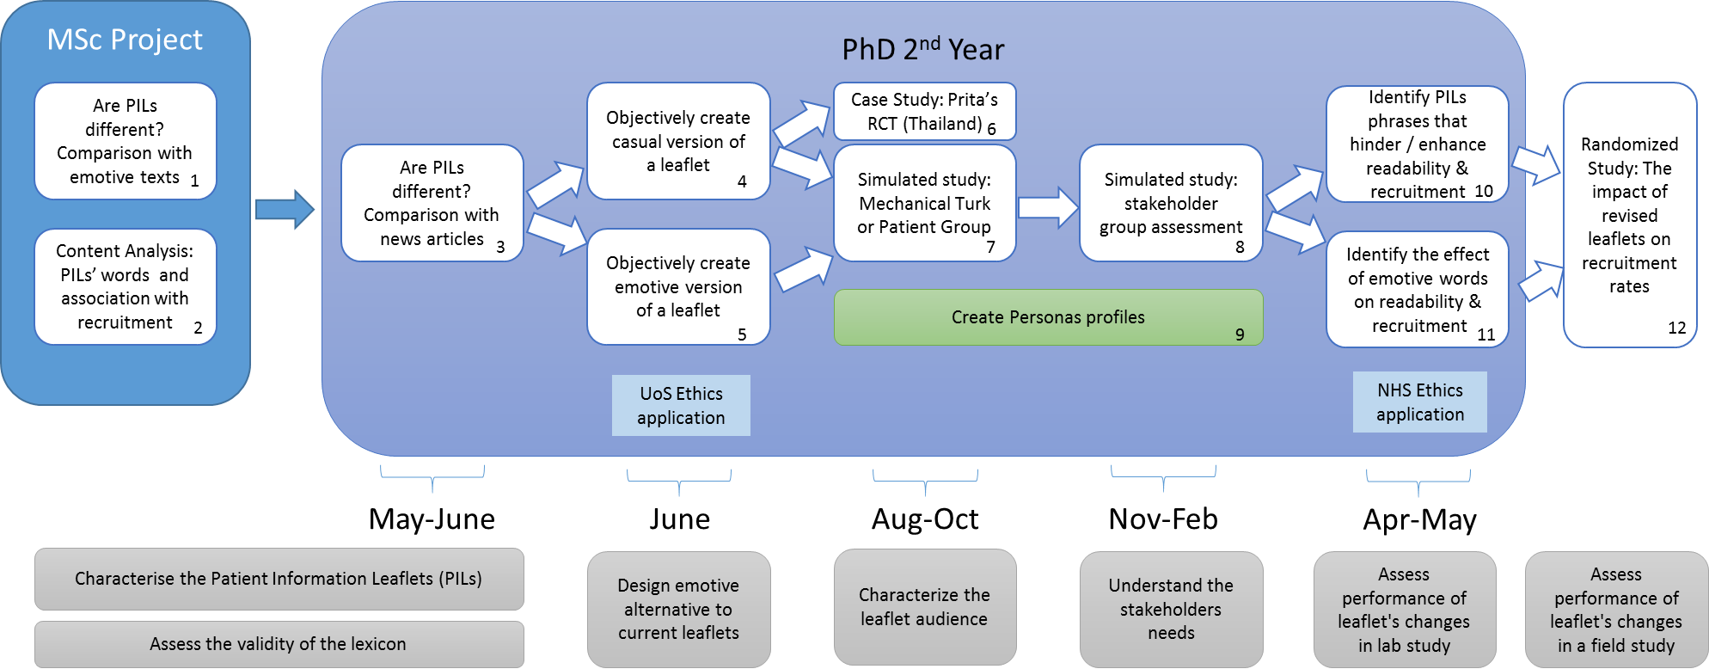

Slide 6
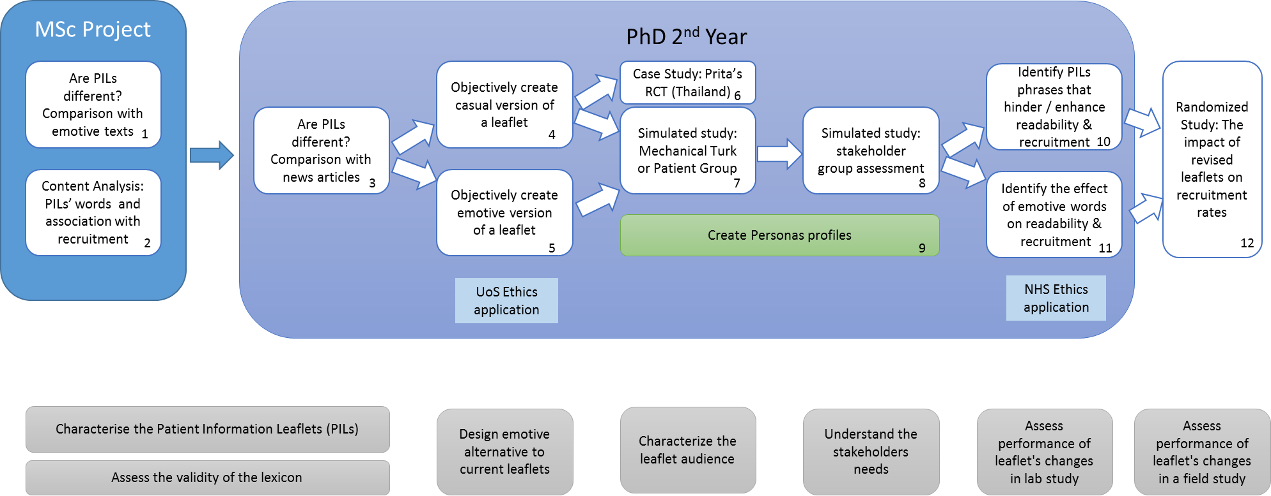

Slide 7
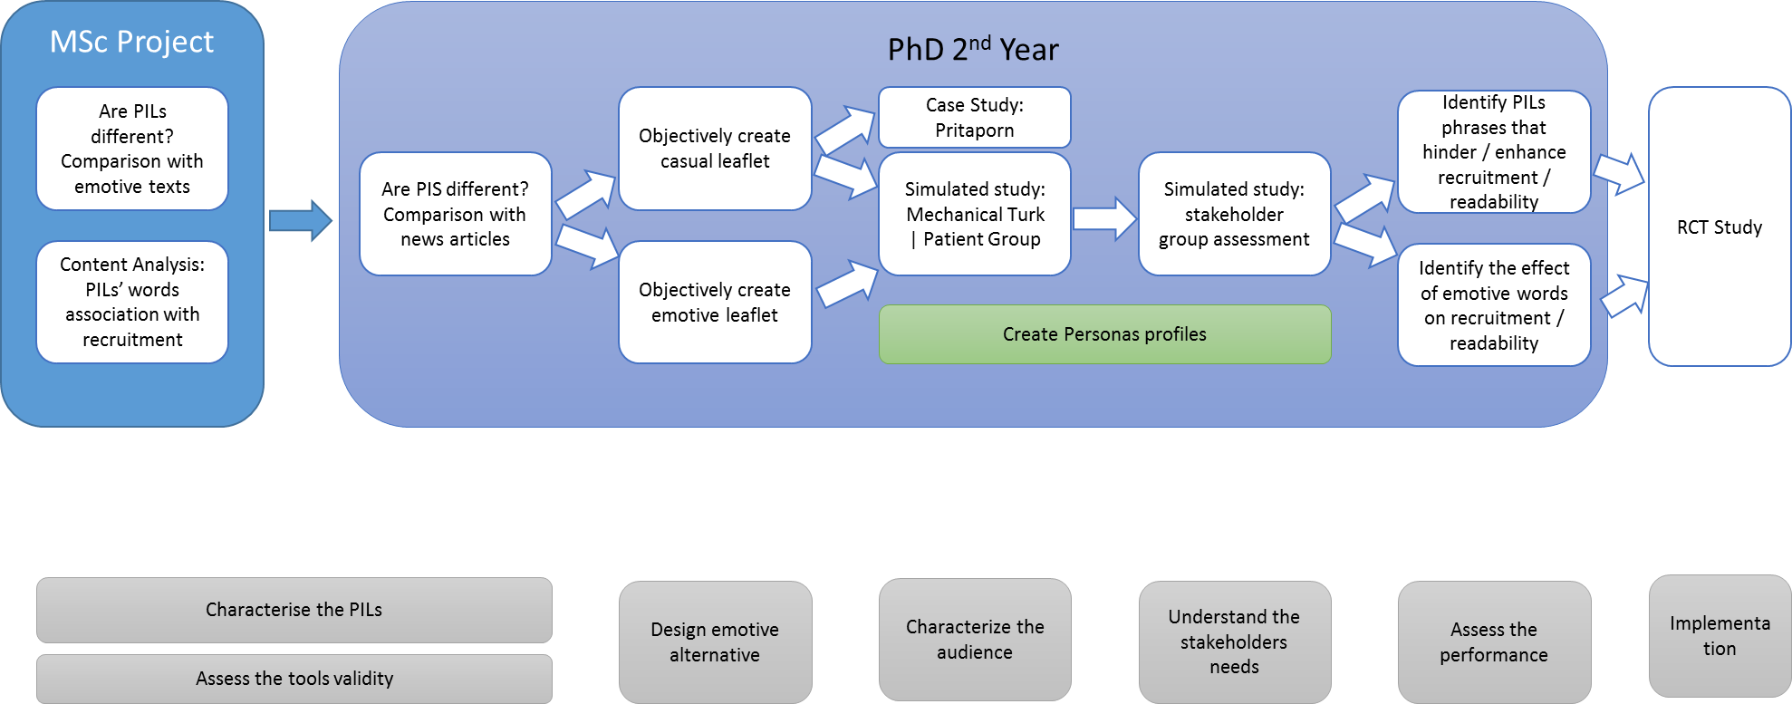
6
1
4
10
3
7
8
2
5
9
11
12

Slide 8
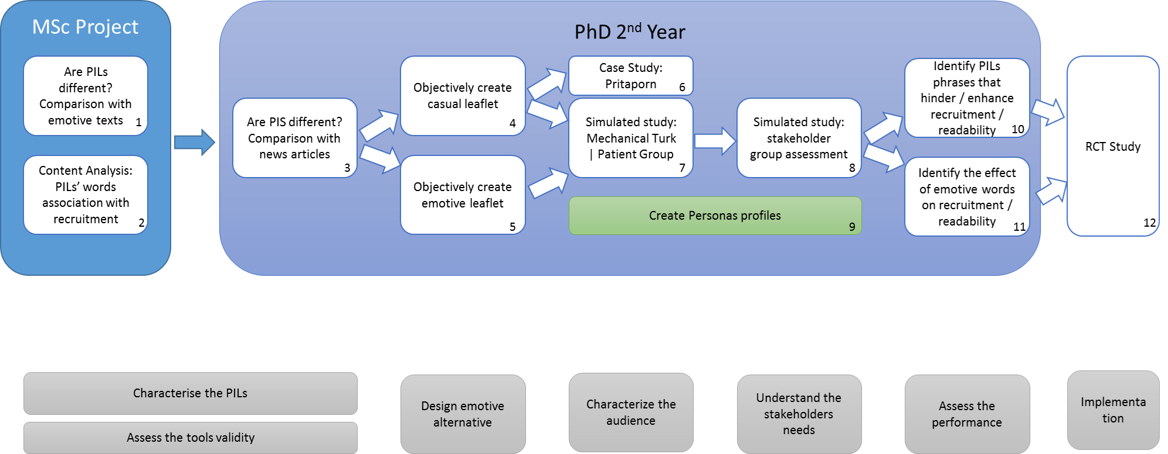

Slide 9
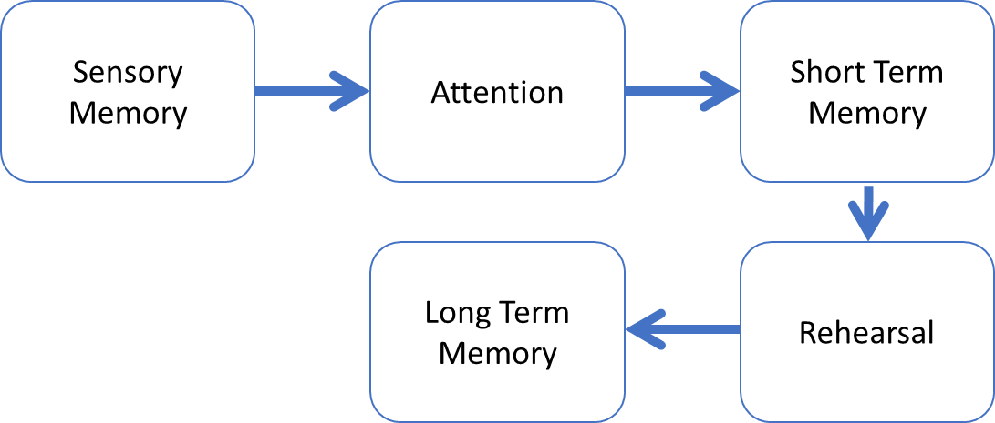
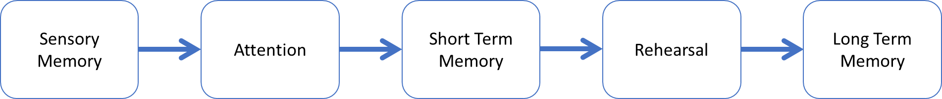
Sensory Memory
Attention
Short Term Memory
Long Term Memory
Rehearsal

Slide 10
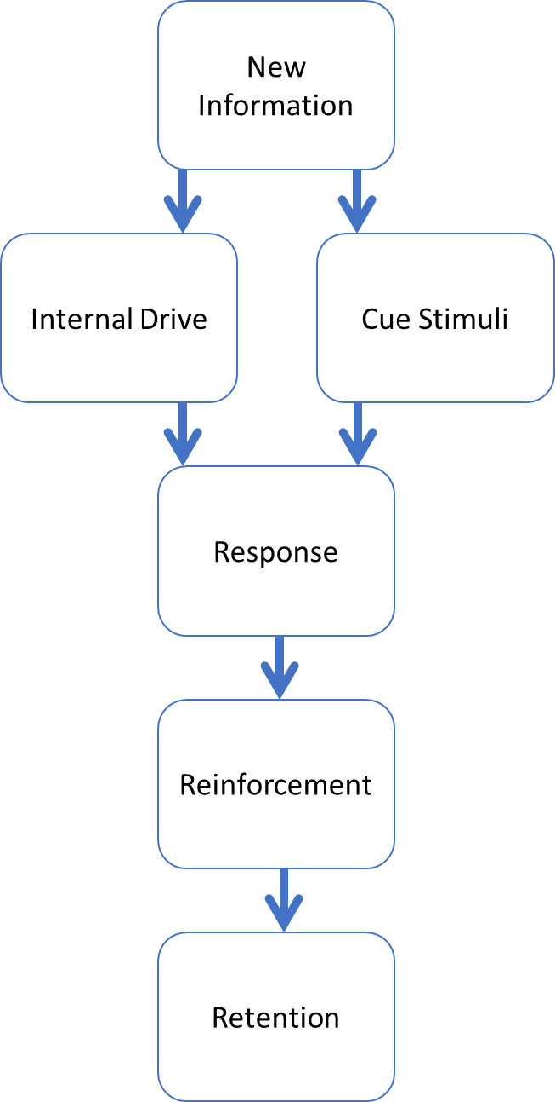
New Information
Internal Drive
Cue Stimuli
Response
Reinforcement
Retention

